Slide 1
How do we address the background?

Slide 2
The ideal is to make the still life objects pop or stand out… after all they are what we have spent so much time on….

Slide 3
So how do we do that…..
The ideal way to create a stunning still life with an effective background is all about value…

Slide 4
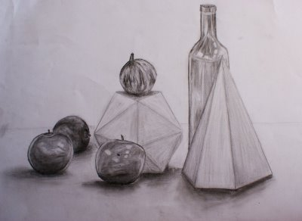
Incomplete or complete?

Slide 5
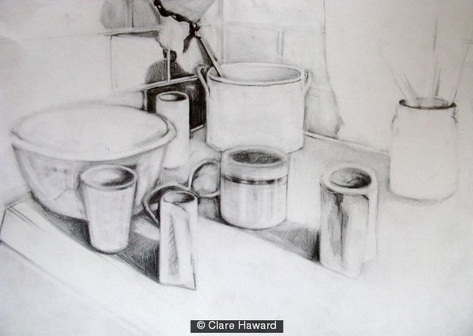
http://www.flickr.com/photos/ammar_aa/2075763217/
What do you think?

Slide 6
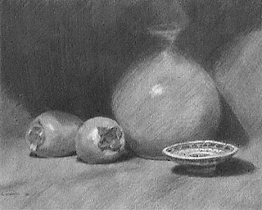
Background alone, what do you think?

Slide 7
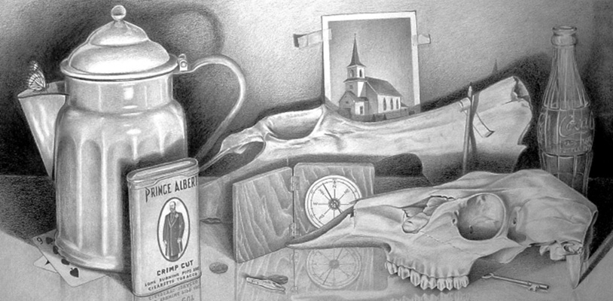
What about this one?

Slide 8
Do you see a difference?

Slide 9
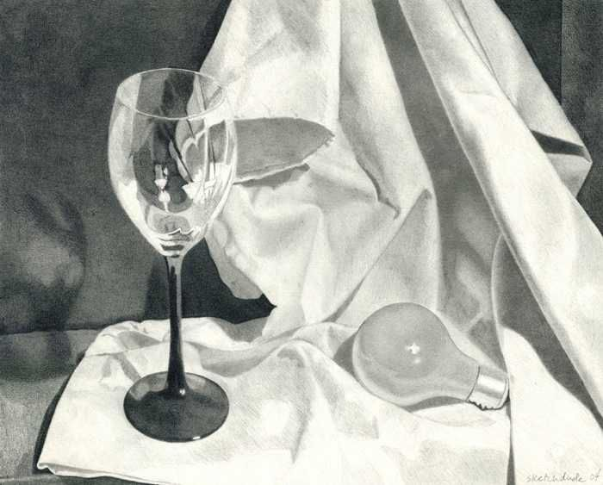

Slide 10
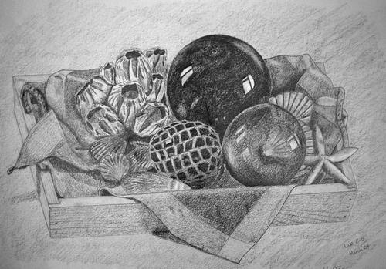
What about this?
Does the background help or look incomplete?

Slide 11
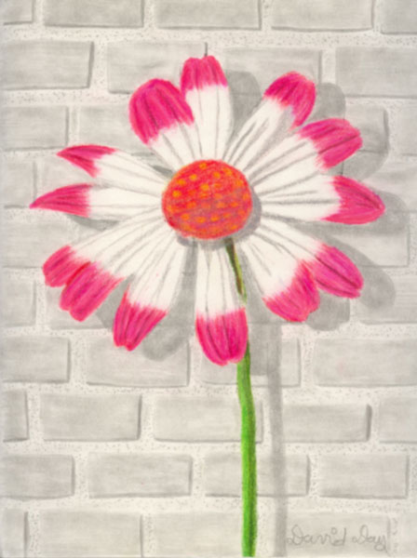
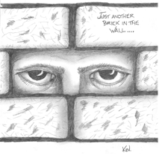
If you want to get creative and add bricks….
This is how it should look , not just lines…

Slide 12
You could add fabric if you want to get really creative….
JUST DO NOT LEAVE EMPTY

Slide 13
Also lets not forget about the surface too, make sure you are adding the cast shadows .

