Slide 1
Come in and get out you sketchbook, color pencils, and worksheet from yesterday

Slide 3

What is color

Slide 4
Color is….
the quality of an object or substance with respect to light reflected by the object, usually determined visually by measurement of hue, saturation, and brightness of the reflected light; saturation or chroma; hue.

Slide 5
What are primary colors

Slide 6
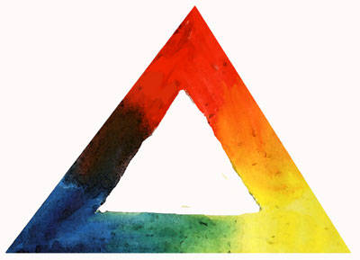
In color mixing for painting, the fundamental rule is that there are three colors that cannot be made by mixing other colors together. These three, red, blue, and yellow, are known as the primary colors.

Slide 7
What happens when you mix 2 primary colors?
If you mix two primary colors together, you create what is called a secondary color. Mixing blue and red creates purple; red and yellow make orange; yellow and blue make green. The exact hue of the secondary color you've mixed depends on which red, blue, or yellow you use and the proportions in which you mix them. If you a primary color and a secondary color together, you get a tertiary color (RO, YO, YG, BG, BV, RV).

Slide 9
So far we know…
Primary colors: colors from which all other colors are made: red, blue, and yellow
Secondary colors: colors that are created from equal amounts of a pair of primary colors: green, orange, violet
Tertiary colors: colors made from equal amounts of a pair of primary and secondary colors: red-violet, blue-violet, blue-green, yellow-green, yellow-orange, red-orange

Slide 10
What about black and white?
Black and white can also not be made by mixing together other colors, but as they aren't used in color mixing to create colors, they get excluded from color mixing theory
Tint: a color plus white
Shade: a color plus black

Slide 11
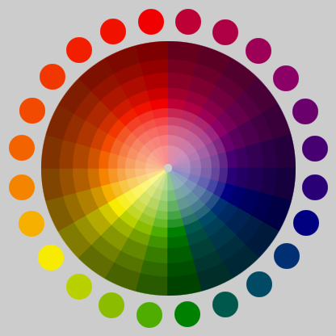

Slide 12
Warm and cool colors
Every color has a certain bias towards what's called warm and cool. It's not something that's overwhelming; it's subtle. But it's an important element in color mixing as it influences the results.
As a group, reds and yellows are considered warm colors and blue a cool color. But if you compare different reds (or yellows or blues), you'll see that there are warm and cool versions of each of these colors (relative to each other only).

Slide 13
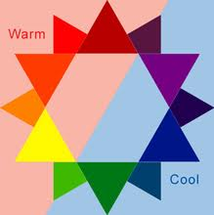

Slide 14
Can red be cool and warm?

Slide 15
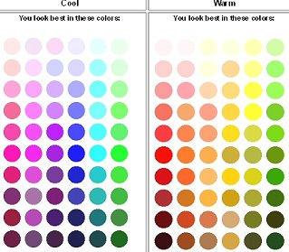

Slide 16
So here is the color wheel….

Slide 17
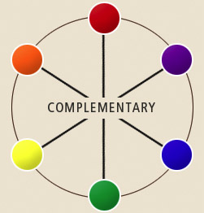
Complementary colors
Complementary colors: the colors opposite on the color wheel: red & green, blue & orange, yellow & violet

Slide 18
What about brown and grey…
Neutral: created by mixing equal amounts of two complementary colors (usually a gray-brown)

Slide 19
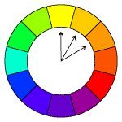
Analogous colors: three consecutive colors on the color wheel

Slide 20
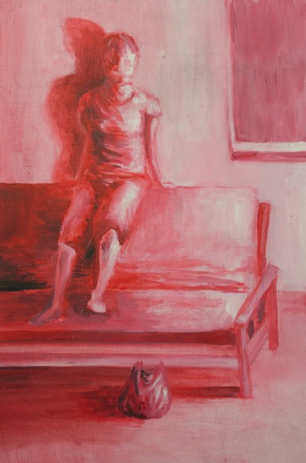
Monochromatic: one color

Slide 21
Color schemes
A set of colors that work together, could be analogous, complementary, primary, etc

Slide 22
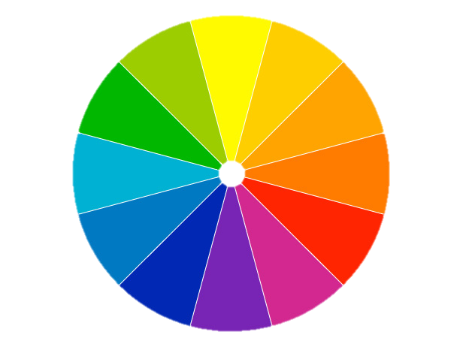
Shade
tint
highlight

Slide 23
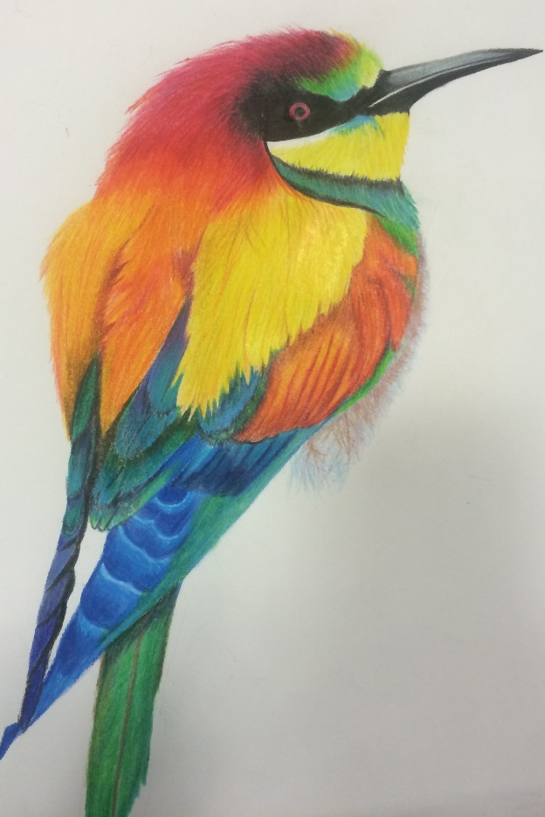
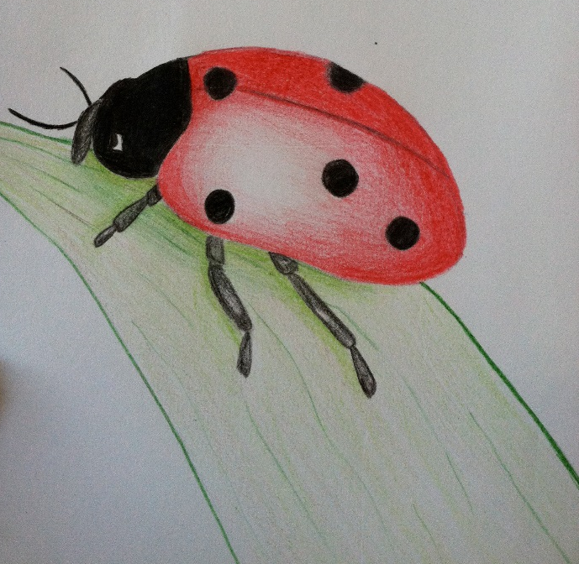
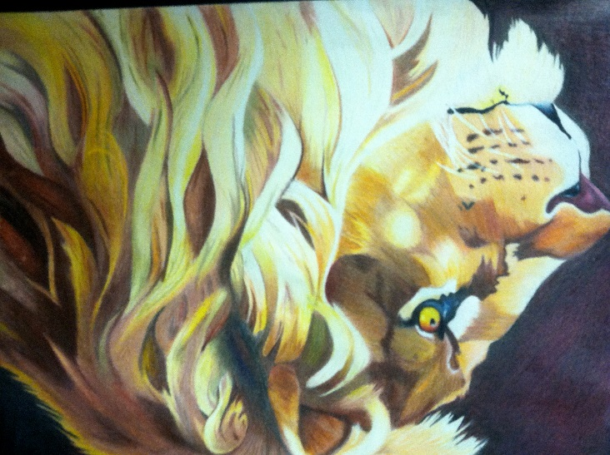
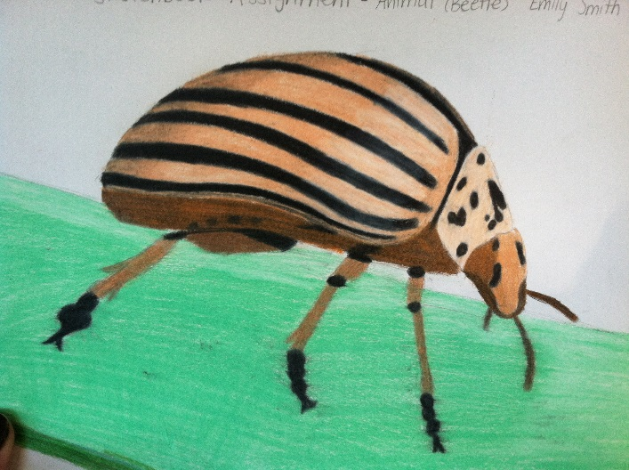
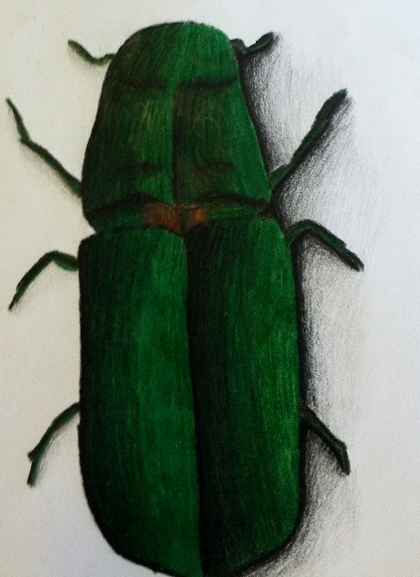
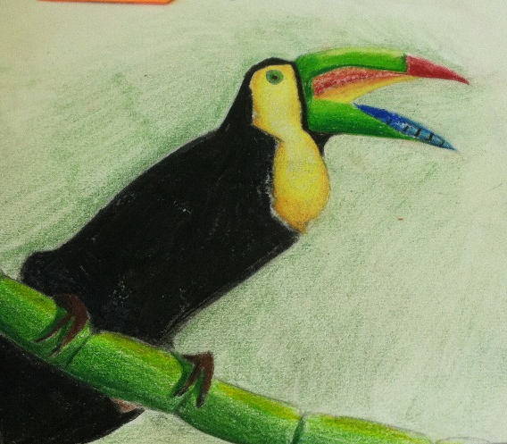
Your next sketchbook: Draw an animal or insect in a realistic style. No cartoon

Slide 24
Color Theory Vocabulary
Primary colors- Colors that cannot be made. Red, Yellow, Blue
Secondary Colors- Colors made by mixing equal parts of 2 primary colors (Orange, Green, Purple)
Tertiary colors- colors made by mixing a secondary and a primary (Red-Orange, Yellow-Orange, Yellow-Green, Blue-Green, Blue-Violet, Red-Violet)
Tint- a color plus white
Shade- a color plus black
Neutrals-browns, tans
Achromatic- black and white
Complementary- A pair of colors across from each other (red-green, Blue-orange, Yellow-Purple)
Analogous colors- a group 3 colors right beside each other on the color wheel (red, red-orange, orange)
Monochromatic- One color with different tints and shades

