Slide 2
Please come in and have a seat.
To Join Remind
Text @nafonahs
To 81010

Slide 3
What is the National Art Honor Society
The National Art Honor Society (NAHS) is designed specifically for high school students in grades 9-12. In 1978, the National Art Education Association began the National Art Honor Society program to inspire and recognize students who have shown an outstanding ability and interest in art. The NAHS strives to aid members in attaining the highest standards in art scholarship, character, and service, and to bring art education to the attention of the school and community.

Slide 4
Welcome
Membership in the NAHS is a privilege. Students considered for membership into the NAHS
-Have completed an art course with a 90 average or higher
-Maintain a minimum GPA of 3.0 weighted SC scale
-Pay local dues yearly ($15 for new, $10 for returning).

Slide 5
Why should you join?
Students become members of a distinguished group of over 46,000 art students.
Students gain peer recognition, leadership growth opportunities, college and career preparation, and an unmatched sense of camaraderie.
Students receive opportunities for publication in the NAHS News (a semi-annual, full-color digital publication), and the National Art Honor Societies Online Gallery.
Juniors and Seniors are eligible for the Rising Stars Secondary Recognition Program Award.
Seniors are eligible to apply for the Charles M. Robertson Memorial Scholarship and scholarships to Columbus College of Art and Design, Maryland Institute College of Art, and The Art Institute.
Impress them! Institutions of higher education view the NAHS as a mark of accomplishment.
Seniors who meet all requirements also are eligible to get a cord for graduation.

Slide 6
As a member you can have art published

Slide 7
What do you have to do?
4 community services hours per semester
4 donations per semester
Attend a minimum of 4 meetings per semester
Meetings are every other Tuesday after school in my room.

Slide 8
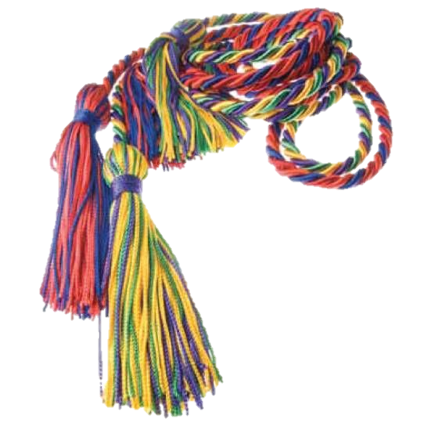
Attendance is required at meetings to maintain membership and privileges. Students must attend a minimum of 4 meetings a semester. NO meetings will be hold during flex
To graduate with NAHS honors and earn the right to wear a cord, pin, or tassel at graduation, a member must remain in good standing until the graduation date. Fees for cords will need to be paid by the middle-end of April.

Slide 9
What happens if you do not meet the requirements?
In the event of an infraction of rules, a review by the officers and sponsors will be conducted. If the individual in question is an officer, he/she will not participate in the decision-making process. This applies to all community laws as well as school and chapter rules.
Basically you will be put on probation and have a few weeks to get things in order or you will be removed.

Slide 10
If you are interested to join…
Take an application packet and fill out the last page.
Pay your fee ($10 for returning, 15 for new) online. Bring last page and a copy of your online receipt to me.
Do all this by September 19th. No exceptions. I would encourage you to do it sooner than later.

Slide 11
If you are interested in running for a office role…
Please respond to the google form I will be sending out later today.
President will be filled by a Senior
Will lead meetings, help with coming up with ideals, plan events, assist in submitting a semi-annual report for the NAHS Magazine
2 Vice Presidents one will be filled by a Senior and one will be filled by a Junior
Will assist in President jobs
Secretary
Will track attendance and help with other information. Also will record the minutes for the meetings. Will work to maintain the NAHS Webpage

Slide 12
Our First Meeting …
Will be on September 19th.
We will vote/announce for the president, vice presidents, and secretary. (Voting will be done online)
We will also discuss possible projects for service hours and sign up for some of them.
Come up with t-shirt designs

Slide 13
Any Questions?

Slide 14
To Join Remind Text @nafonahs To 81010

