Slide 1
Showing Depth

Slide 2
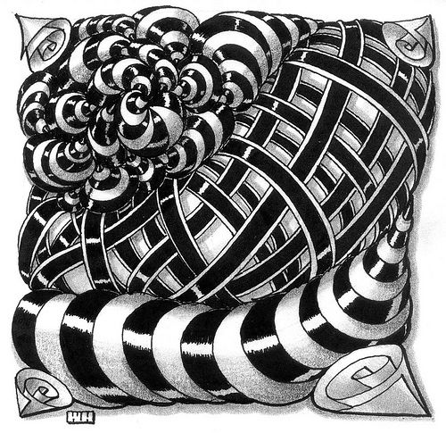
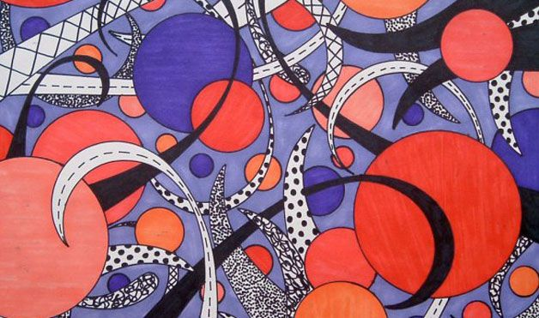
Looking at these images: Explain how these images show depth

Slide 3
Ways to show depth
Overlapping objects
Have objects diminish in size as they “recede” back
Have the values be different. Lighter in front and darker in back or vice versa.
Create shadows on to objects that overlapping

Slide 4
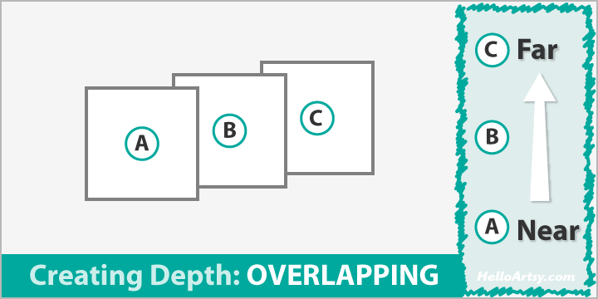

Slide 5
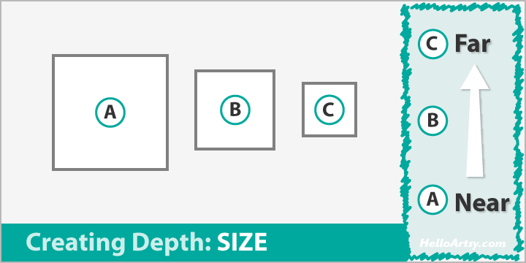

Slide 6
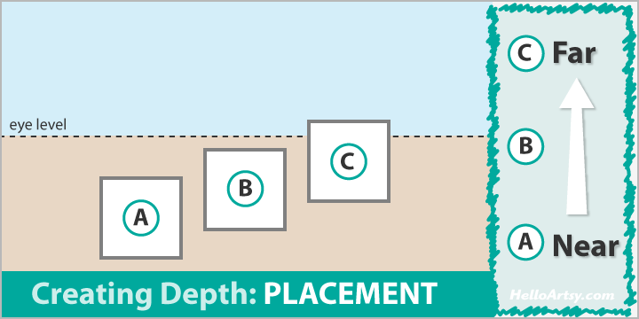

Slide 7
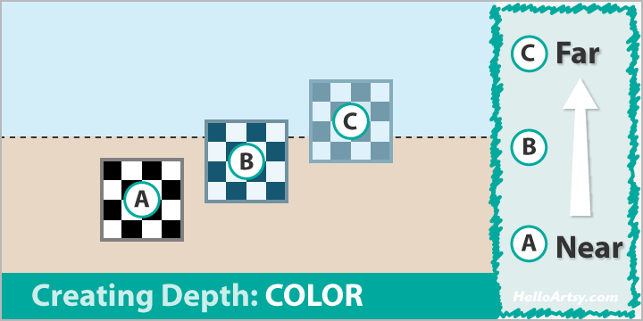

Slide 8
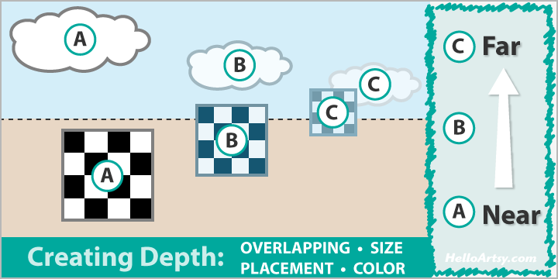

Slide 9
Homework Due 1 week from today
Create a drawing using either sharpie or graphite showing depth using these techniques. The drawing could be abstract with realistic elements
Create a drawing using the same shapes/objects not showing depth.

