Slide 1
NAHS Meeting
9/20/2016 I will do a roll call for attendance in just a minute
Todays meeting should last about 20-30 minutes

Slide 2
Requirements
In order to be in good standing each member must complete 6 hours of “community service” 3 hours minimum the first semester. Each hour equals 10 points.
You will need 40 points towards donations. These will be outlined as we go. In the fall we will collect for the Levine’s Children Hospital and in the Spring we will collect for teachers. Each donation is worth 5 points.
You must attend 4 meetings a semester. There will not be make up meetings during flex. If you missed a meeting you need to go to my personal website to find out what you missed.

Slide 3
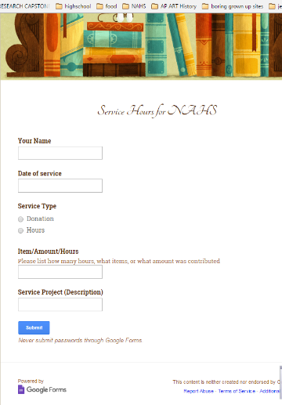
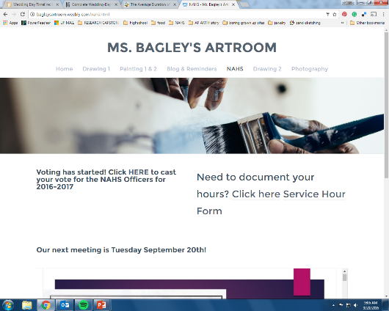
To document your hours and donations:

Slide 4
About community service
This is an ARTS academic honor society. Which means there is art related to it. If you cannot draw then I would encourage you to do the hours at the art show or holiday bazaar. If you are more 3d please talk to me one on one. If you are more digital talk to me about that too.

Slide 5
Fall community service
MURALS
Levine’s Children Hospital arts and craft donations
Induction donations
Holiday bazaar
Middle school mural
Fall art show

Slide 6
Spring Community Service
Earth day sale
Spring art show
Community art for local businesses
Teacher donation

Slide 7
What will happen during the meetings
We will discuss upcoming events
Do meeting service projects
Plan new events
Or work on art
Meetings will be every other Tuesday from now on.

Slide 8
Induction Ceremony
For new members and officers
Our tentative plan is to have the induction ceremony on November 1st at 5:30. It should last 30-45 minutes
Sunday dress is required

Slide 9
Art/craft donation
All donations for Children’s Hospital will need to be turned in to me before Thanksgiving break.
For an approved list of items visit my website.

Slide 10
Art show/ Bazaar/ Other
Art show will be a Thursday in December 5:30-6:30 roughly (not sure on date)
Holiday Bazaar will be November 12th 10am – 3pm (with 2 hours for set up and clean up. Will be broken down into 2 ½ hour shifts
Clean up. Once a month 2 people can sign up to clean up around the classroom and storage closet for 2 hours.

Slide 11
Murals -teachers first
Mrs. Meija (m)
Mrs. Dreher (m)
Mr. Natsis (H)
Mrs. Cornwell (h)
Mr. Solt (m)
Mrs. Sain (h)
Mr. Figuero (e)
Mrs. Byrd (E)
Mrs. Gibson (m-h)
Mrs. Jackson (E)
Mr. Quinlan (m)
Mrs. Thompson (?)
THEN THERE ARE 7 more on the waiting list

Slide 12
My website bagleysartroom.weebly.com

