Slide 1
NAHS Meeting 10/18/2016
Come in and have a seat, grab a shirt design ballot

Slide 2
First thing: vote on shirts
We have narrowed it down to five designs… we will show all of them so that you can vote

Slide 3
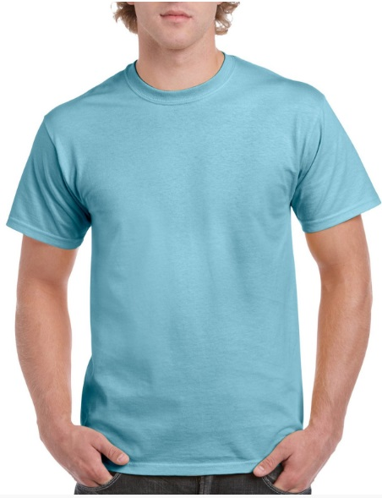
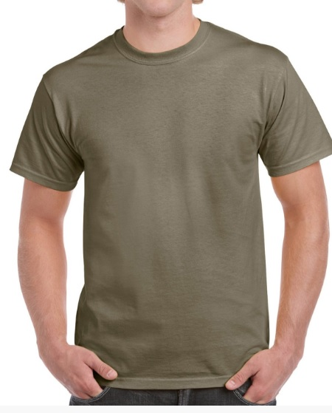
First the color options:
Prairie dust
sky

Slide 4
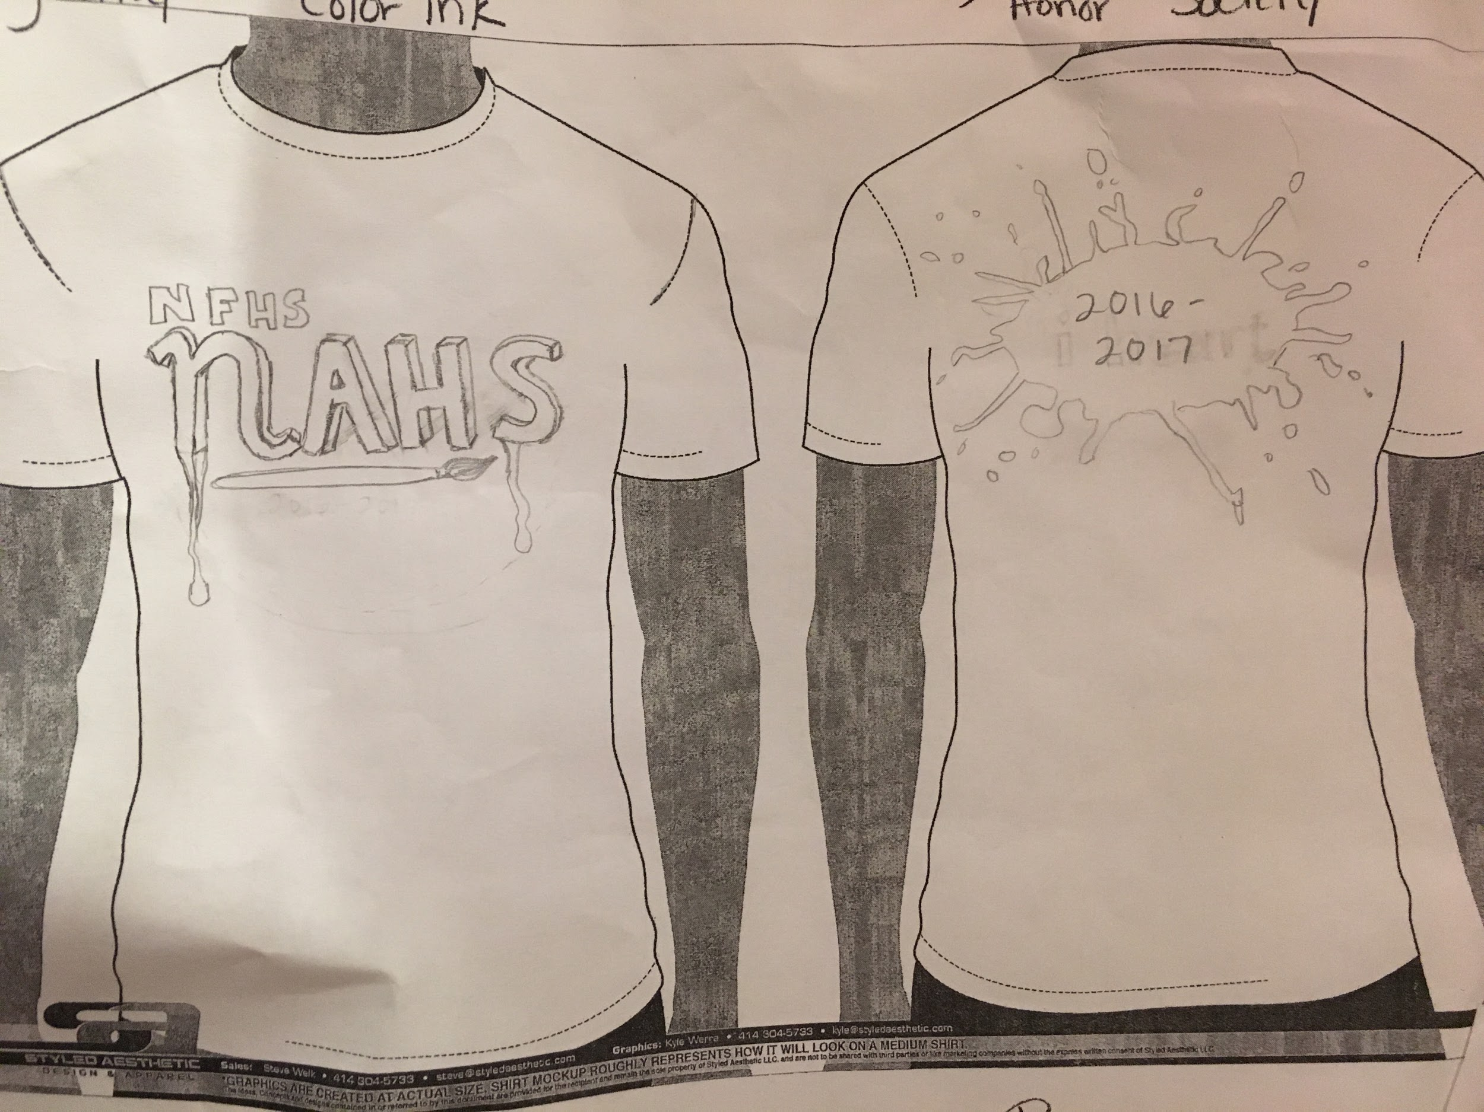
Design 1 (rough draft)

Slide 5
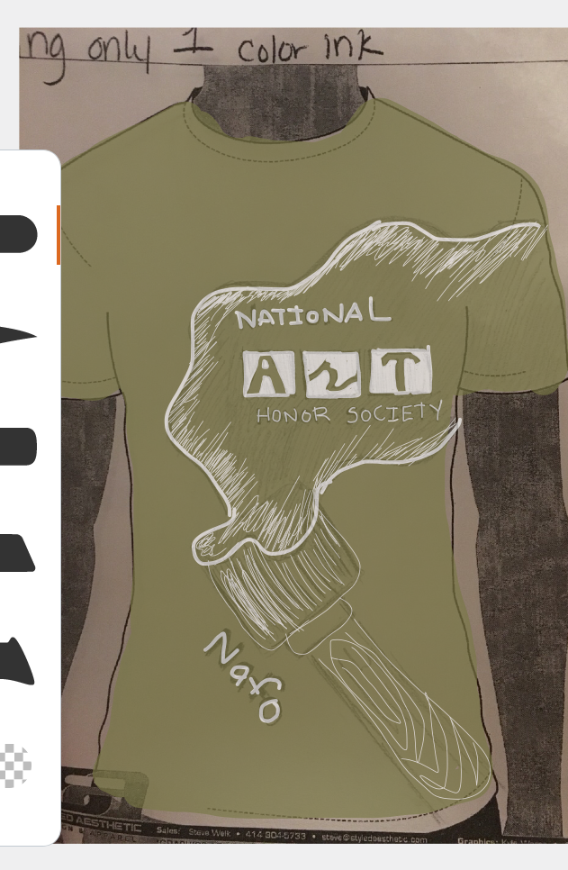
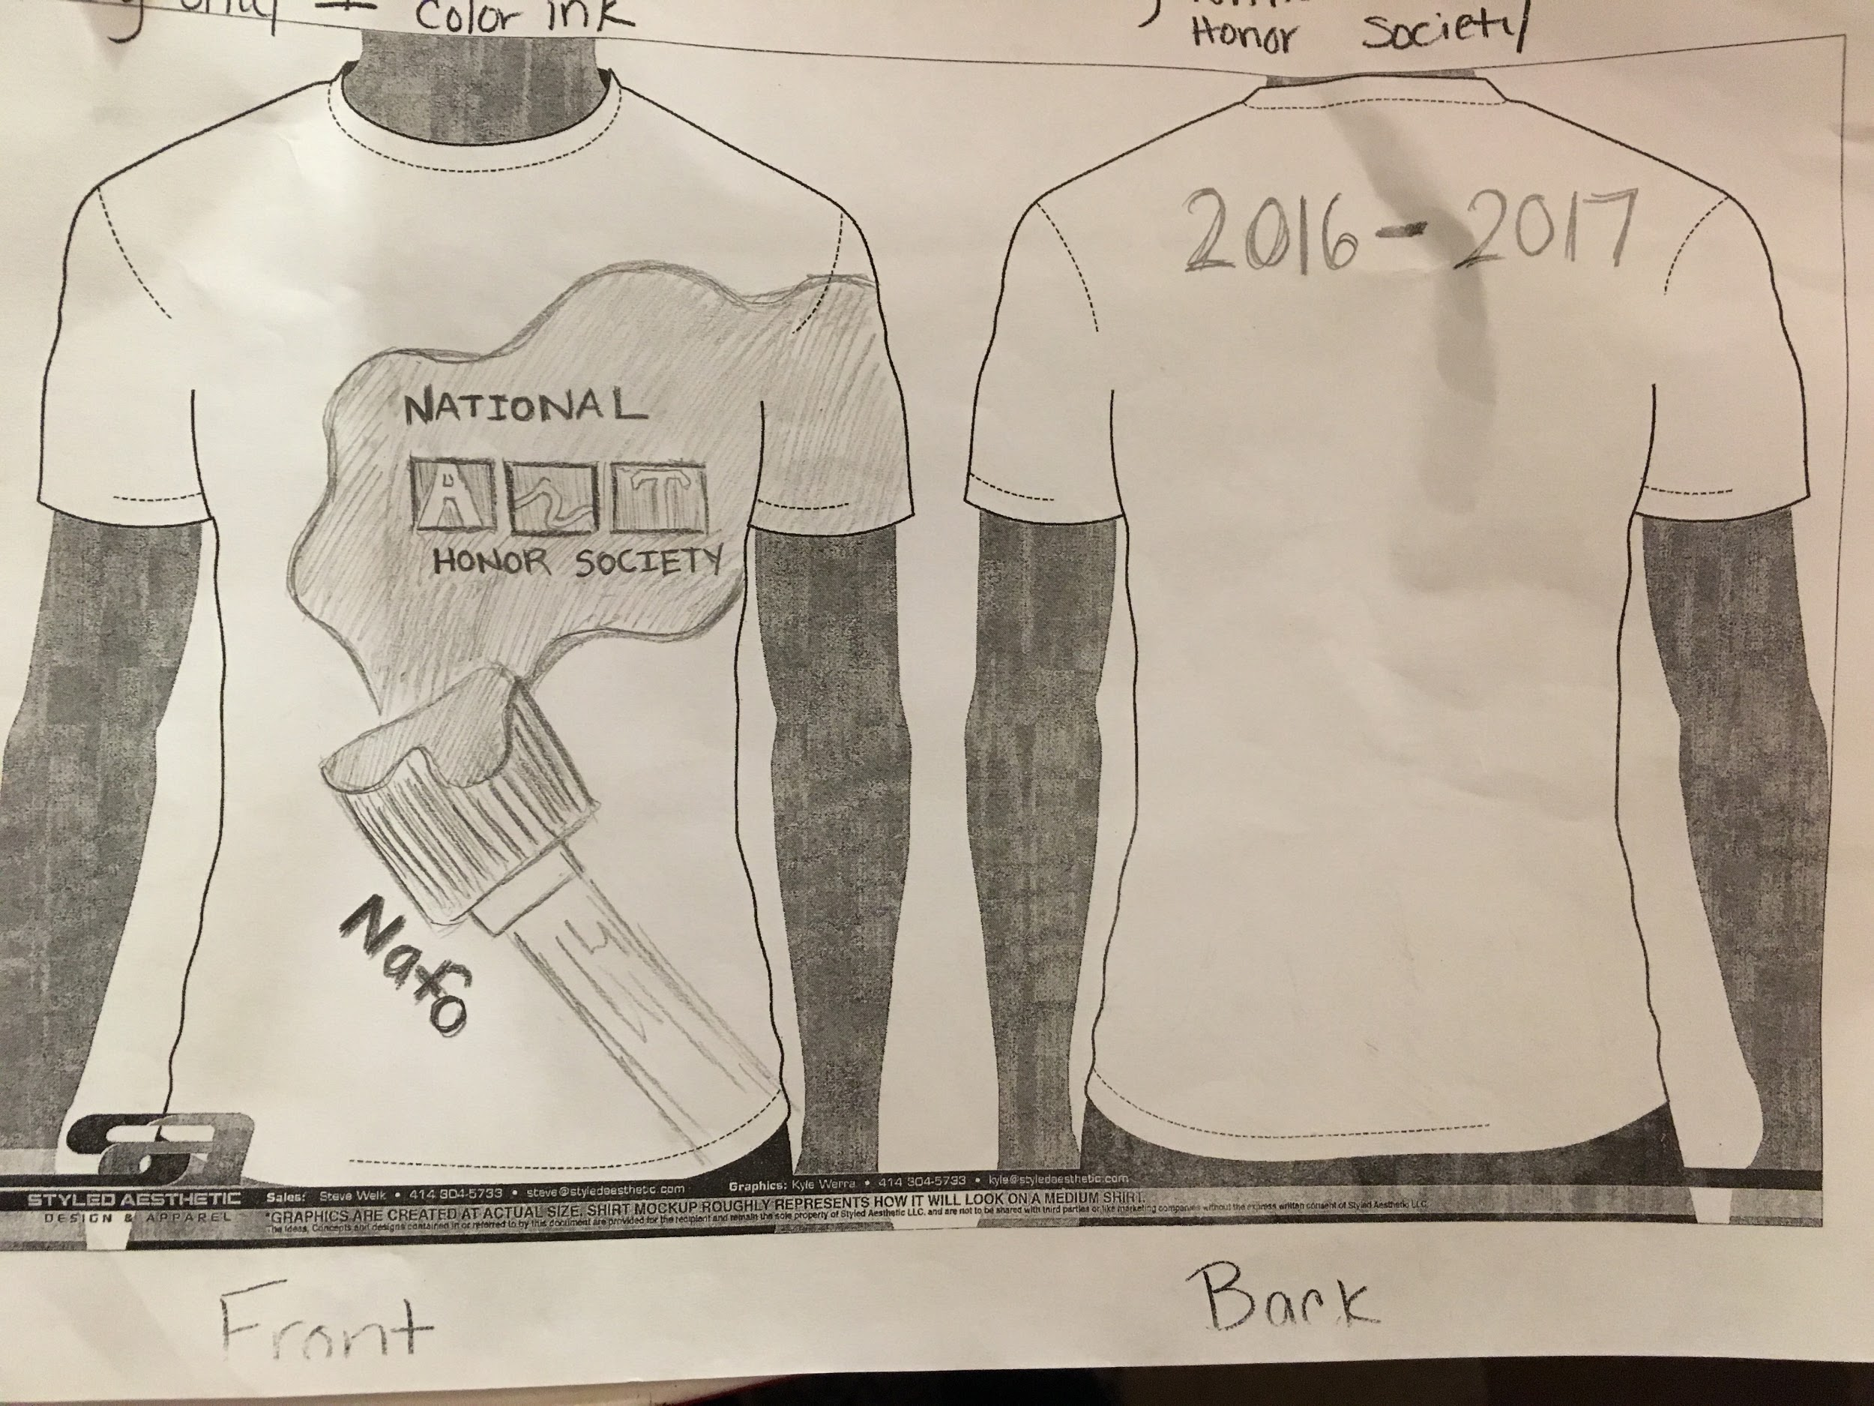
Design 2 (rough draft) THE WINNER!!!!!!!!!!!!!!!!!!!!!!!!!!!!!!!!!!!!!

Slide 6
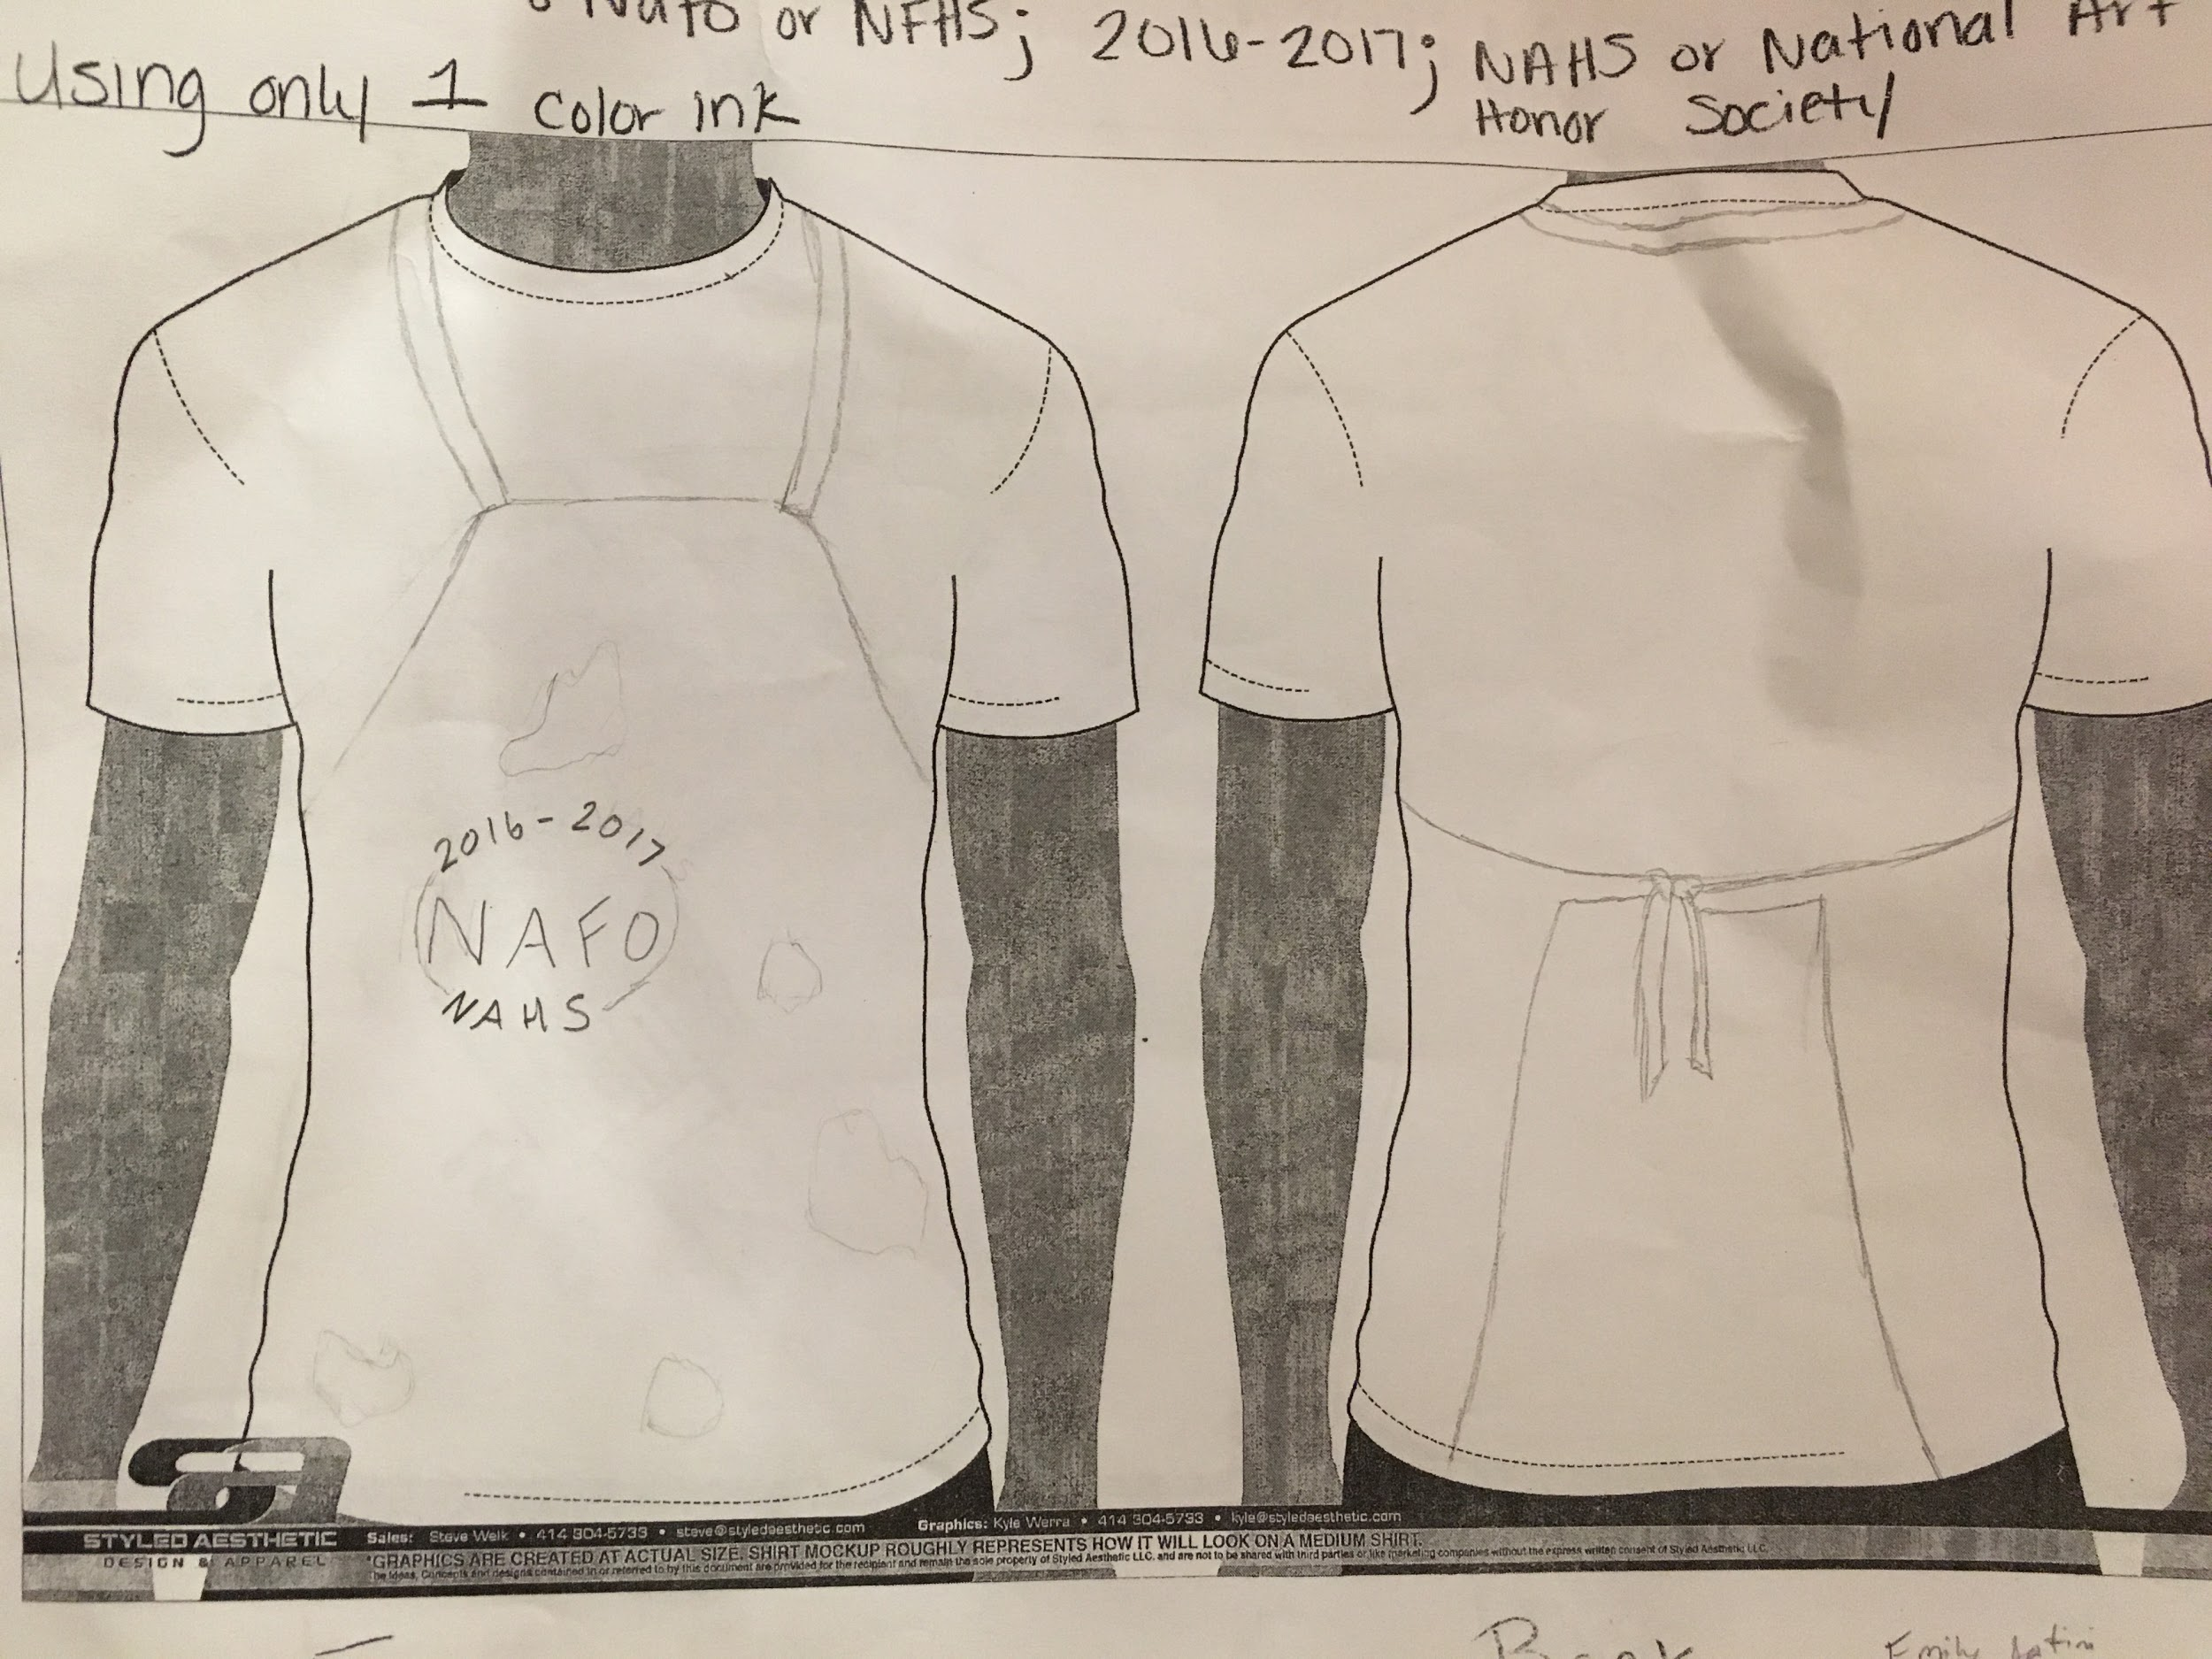
Design 3 (rough draft)

Slide 7
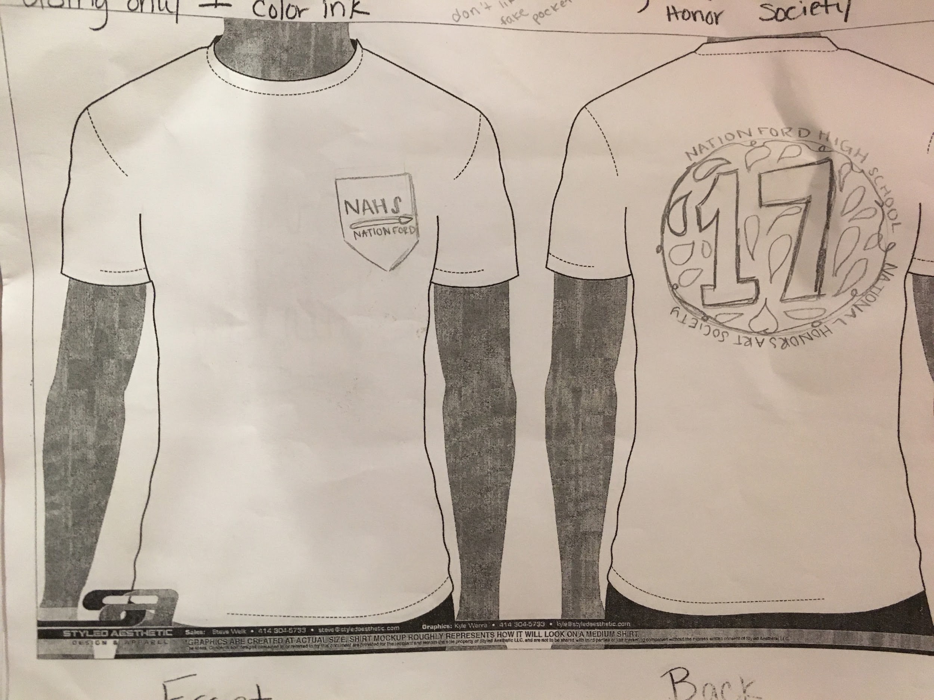
Design 4 (rough draft)

Slide 8
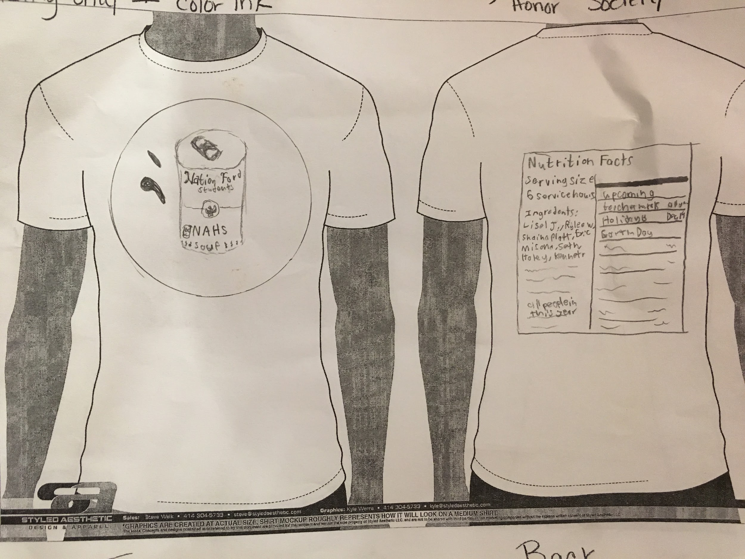
Design 5 (rough draft)

Slide 9
All of them again
c
b
a
e
d

Slide 10
Induction...
November 1st, 2016 from 5:30 - 6:30 pm
Invites on the front table (new members only)
Sunday dress required

Slide 11
Updates:
Levine Children’s Hospital donations
Due by Thanksgiving break
Ms. Bagley has an announcement about murals****

Slide 12
Murals
Groups that have made sufficient progress since the last meeting
Gibson
Byrd (99 % done)
Natsis
solt
Groups that need to seriously get the ball going
Cornwell Thompson
Meija Sain
Figuero (NOTHING)
Dreher (NOTHING)
Jackson (NOTHING)
Quinlan (NOTHING)

Slide 13
Today’s Goals:
Banners- We will be making small banners for the children at the Levine Hospital
Info on what to put on them is on the website********
Work on them for 20-30 minutes
Murals
Rest of meeting time
Ms. Bagley has info on staying in touch with other group members

